Slide 1
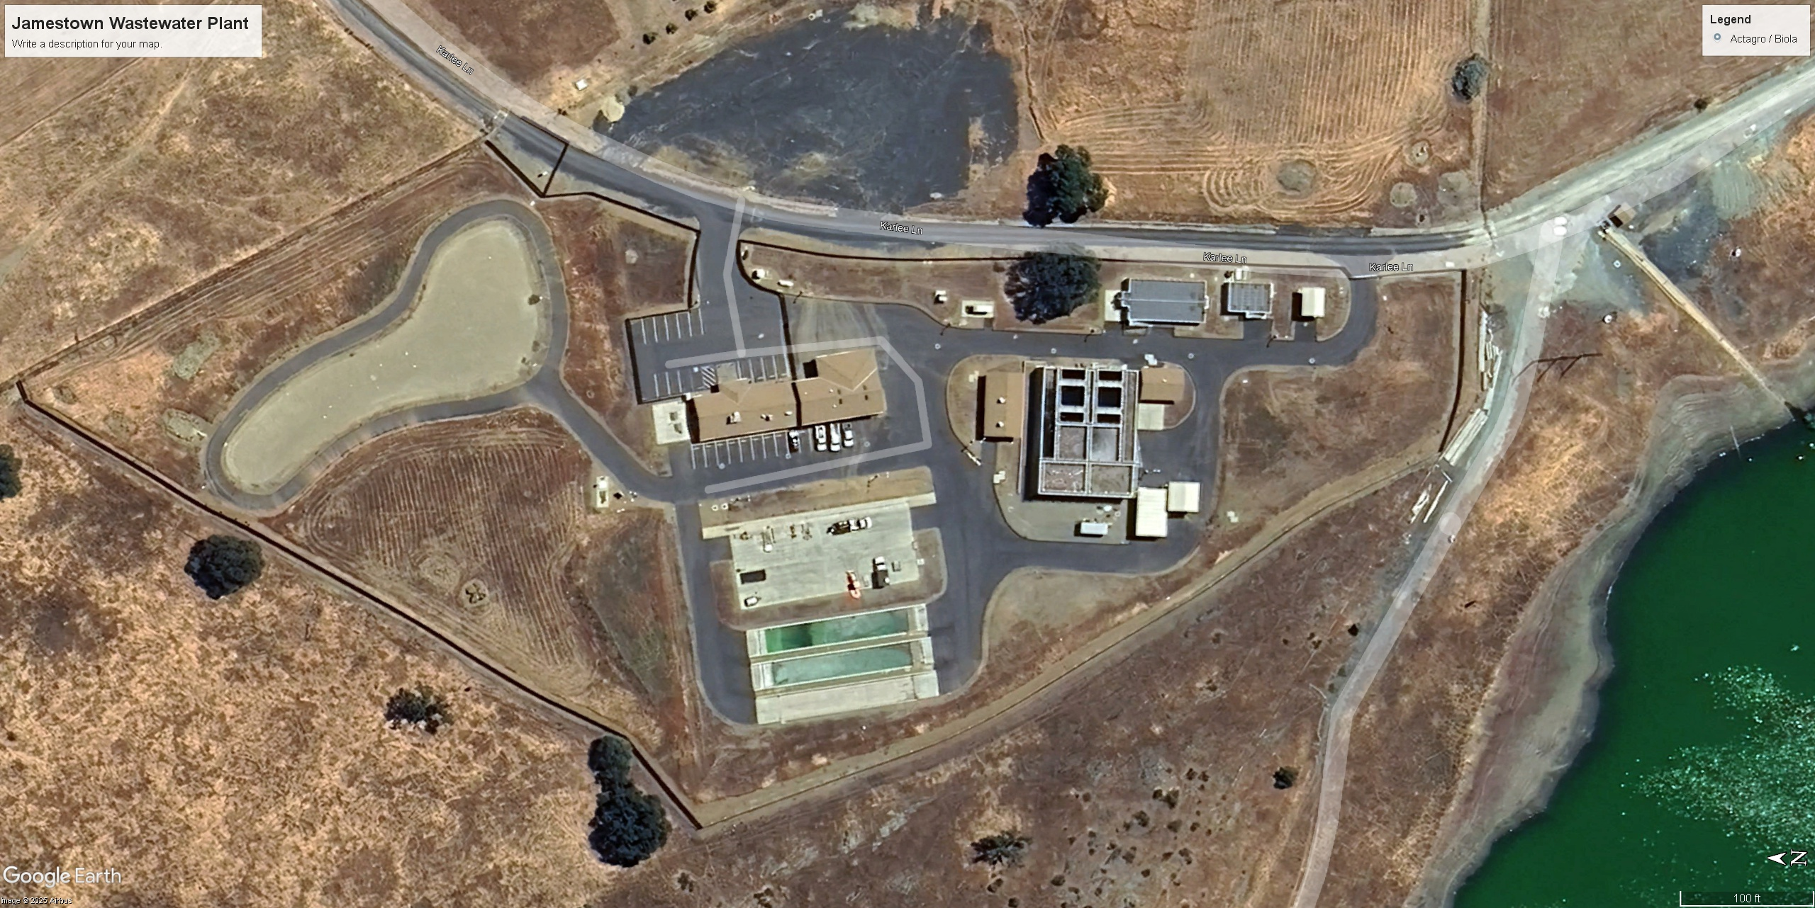
Wastewater Treatment Plant
Tour in Jamestown

Slide 2
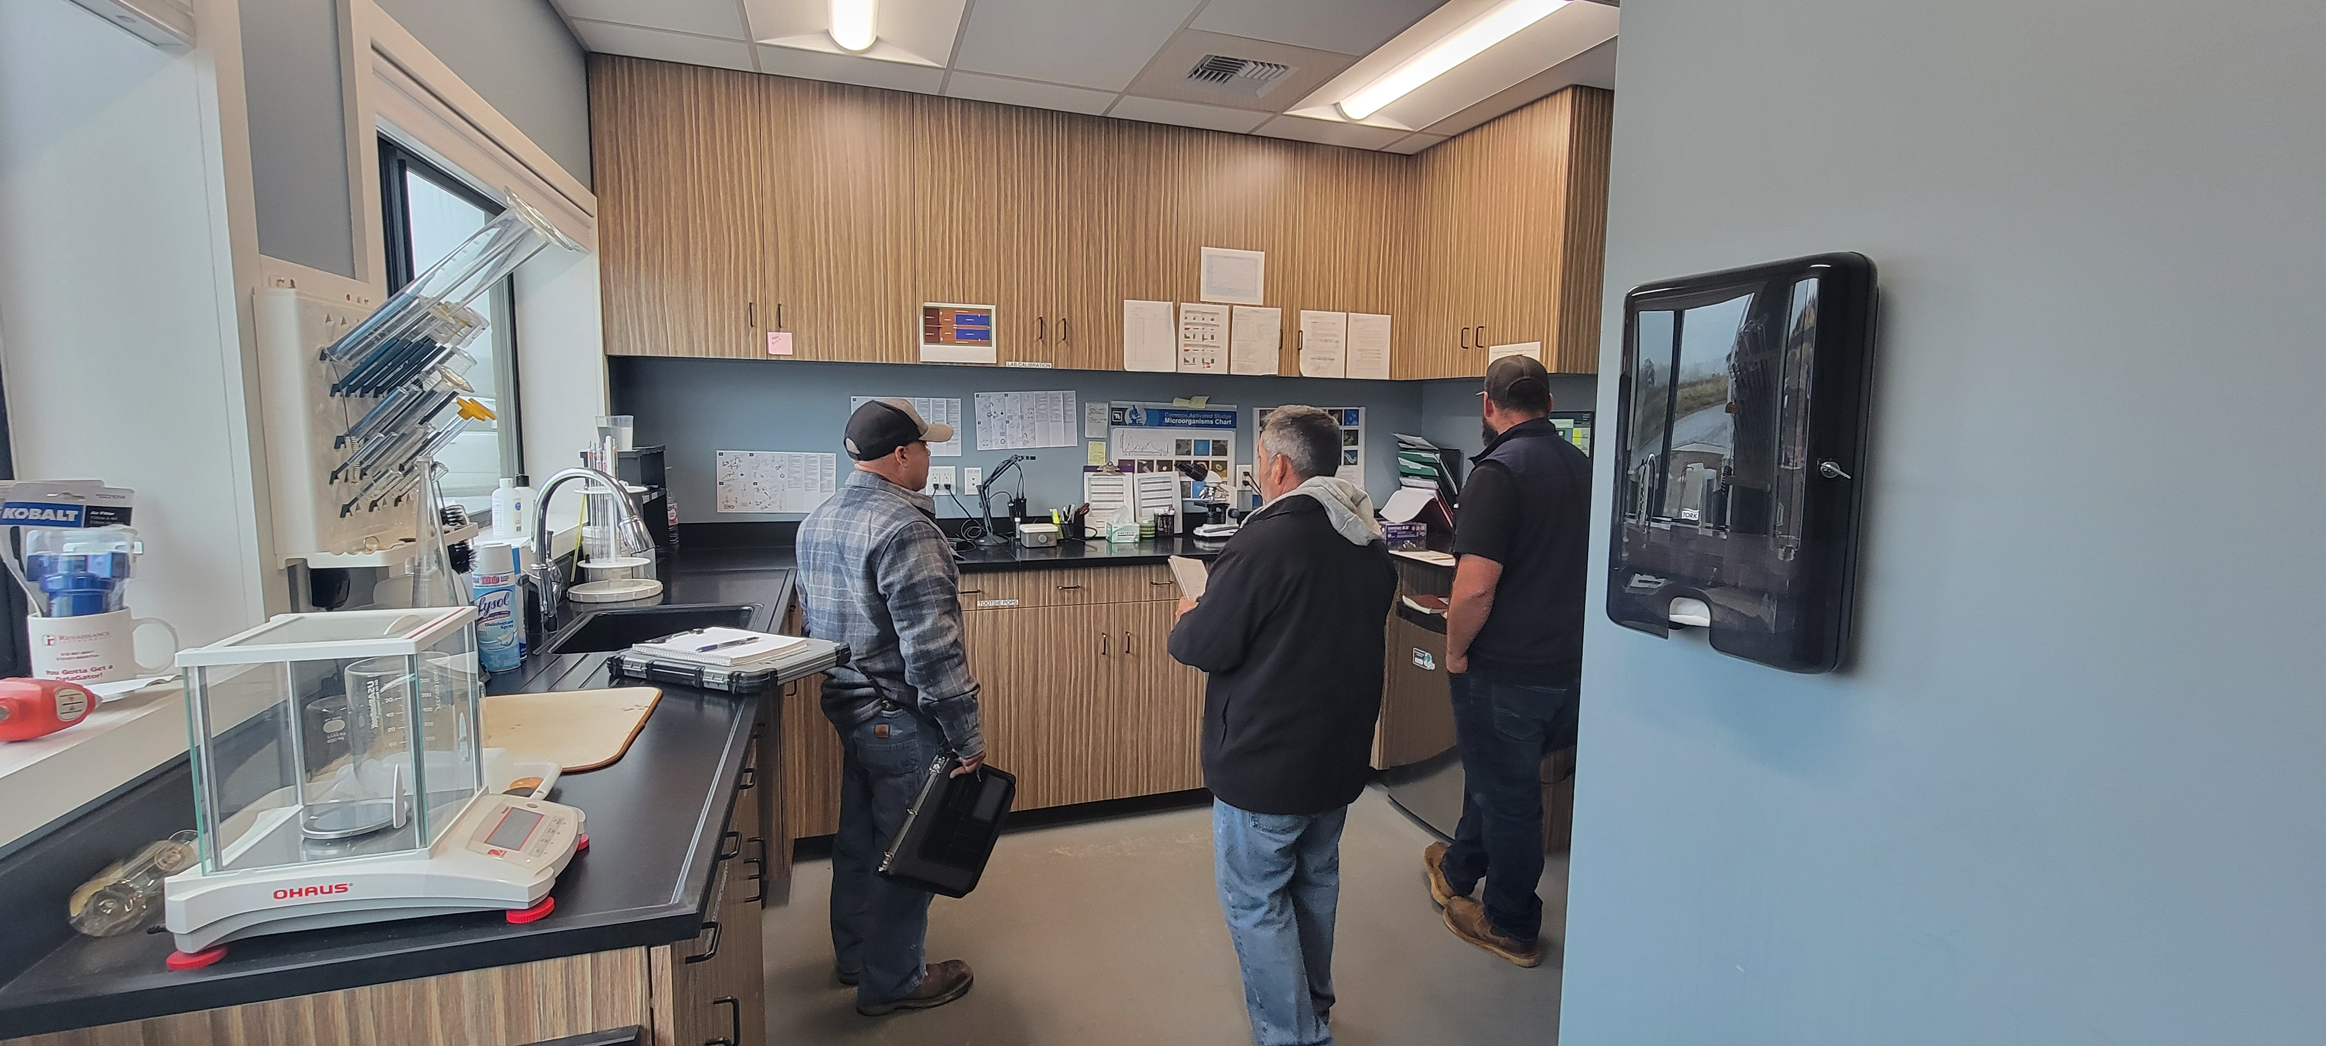
The Jamestown tour was setup to get a better understanding of the new treatment plant designed for Biola CSD. Two Biola board members attended the tour, Chuck and Eugene along with James Bell of Mountain Valley Environmental Services.
Jamestown Laboratory

Slide 3
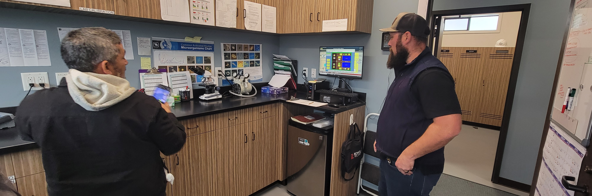
SCADA COMPUTER
The Jamestown wastewater plant is an Aeromod design very similar to the one designed for Biola CSD. The plant requires 24/7 monitoring. The monitoring is accomplished with a Supervisory Control And Data Acquisition (SCADA) program and an on-call operator. This plant also requires 3 fulltime operators to operate efficiently.

Slide 4
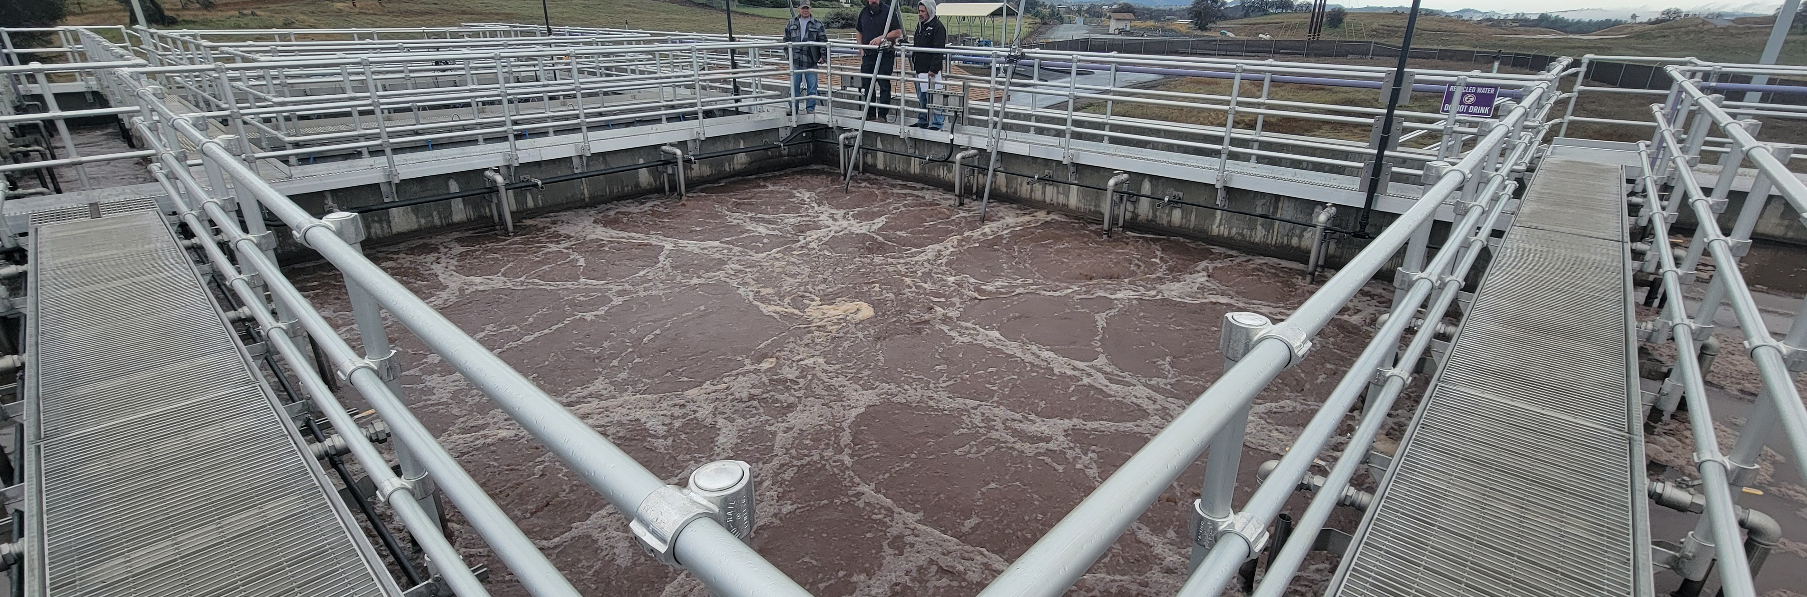
AERATION BASIN
The current wastewater treatment plant serving Biola is an aerated pond system. The new plant would be an activated sludge plant. An activated sludge plant can be an effective and efficient wastewater treatment plant. This is an aeration basin. The basin is getting aerated and mixed with air diffusers at the bottom. The air is supplied by a series of blowers.

Slide 5
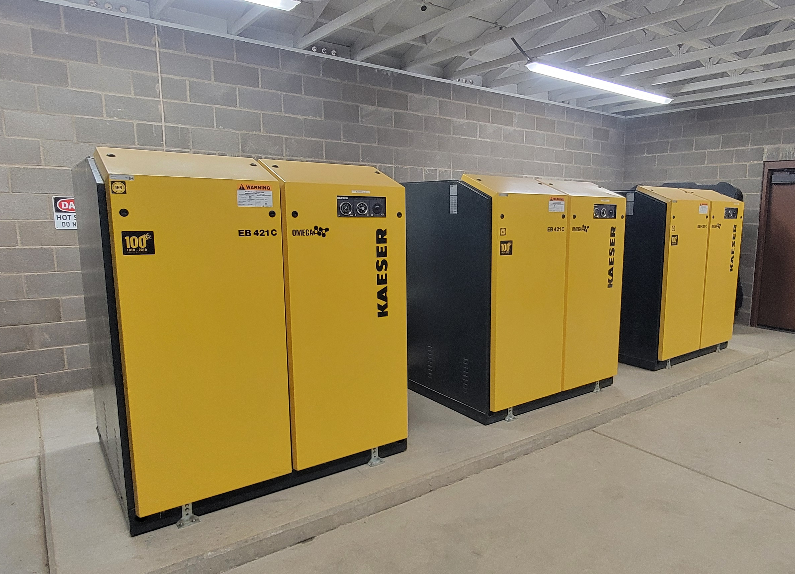
These are the blowers that supply air to the aeration basin diffusers. They require routine maintenance. The maintenance performed includes regular air filter and oil changes. If the blowers are not maintained properly, they can be expensive to repair or replace. These type of blowers are very quiet during operation.

Slide 6
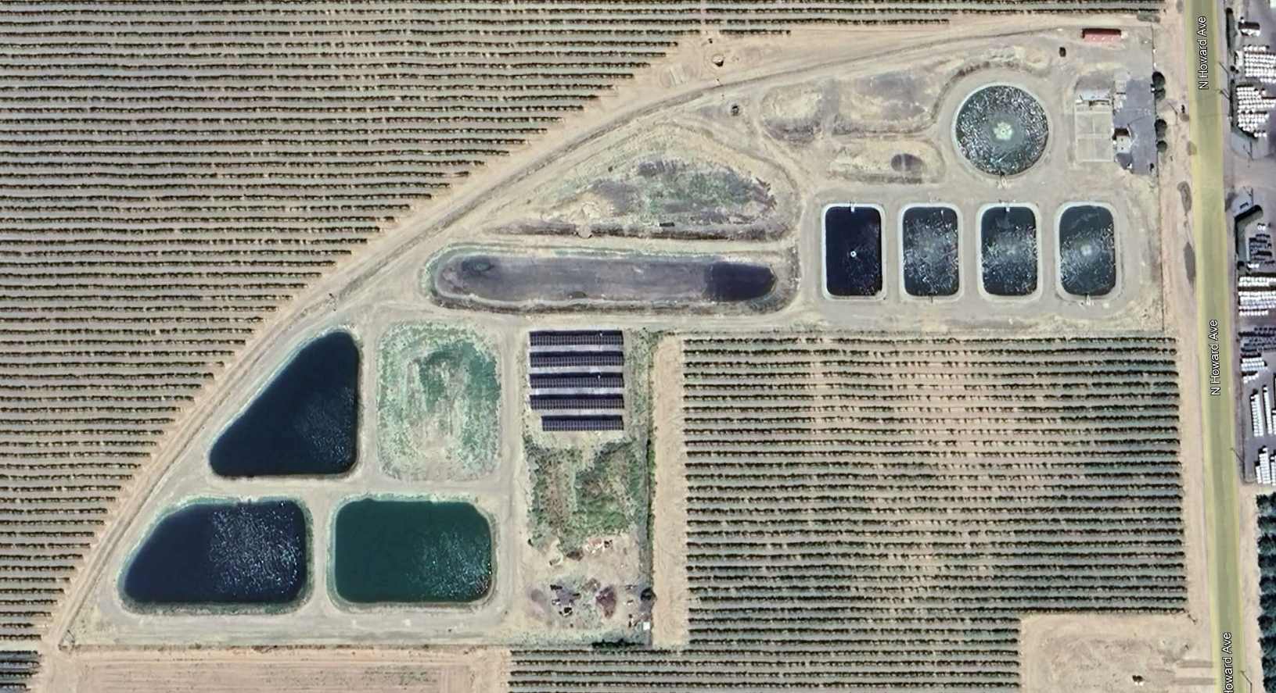
Aerial View of Jamestown
Aerial View of Biola

Slide 7
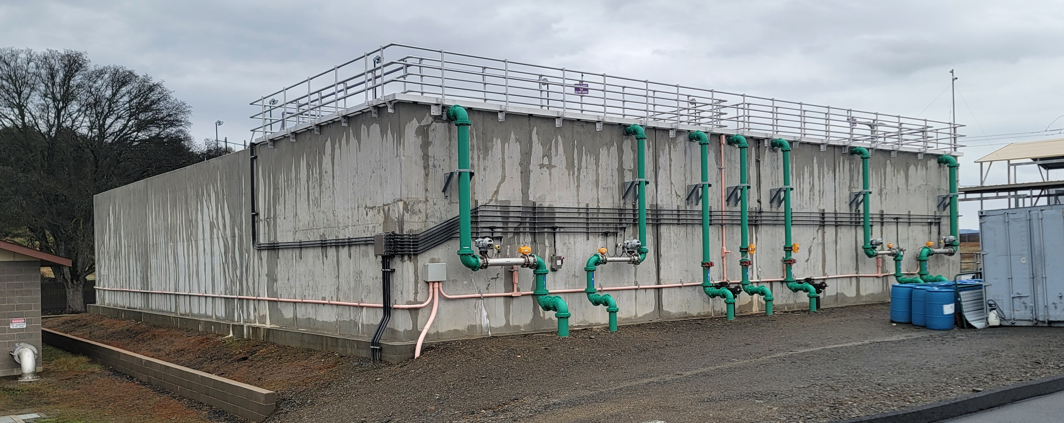
The Jamestown treatment plant also presents some unique maintenance requirements. The entire facility is above ground. When any equipment of size or weight needs to be removed for maintenance, it requires a crane service to be called out. This adds to the overall cost of maintaining their plant as well as delays in the repair of critical equipment.

Slide 8
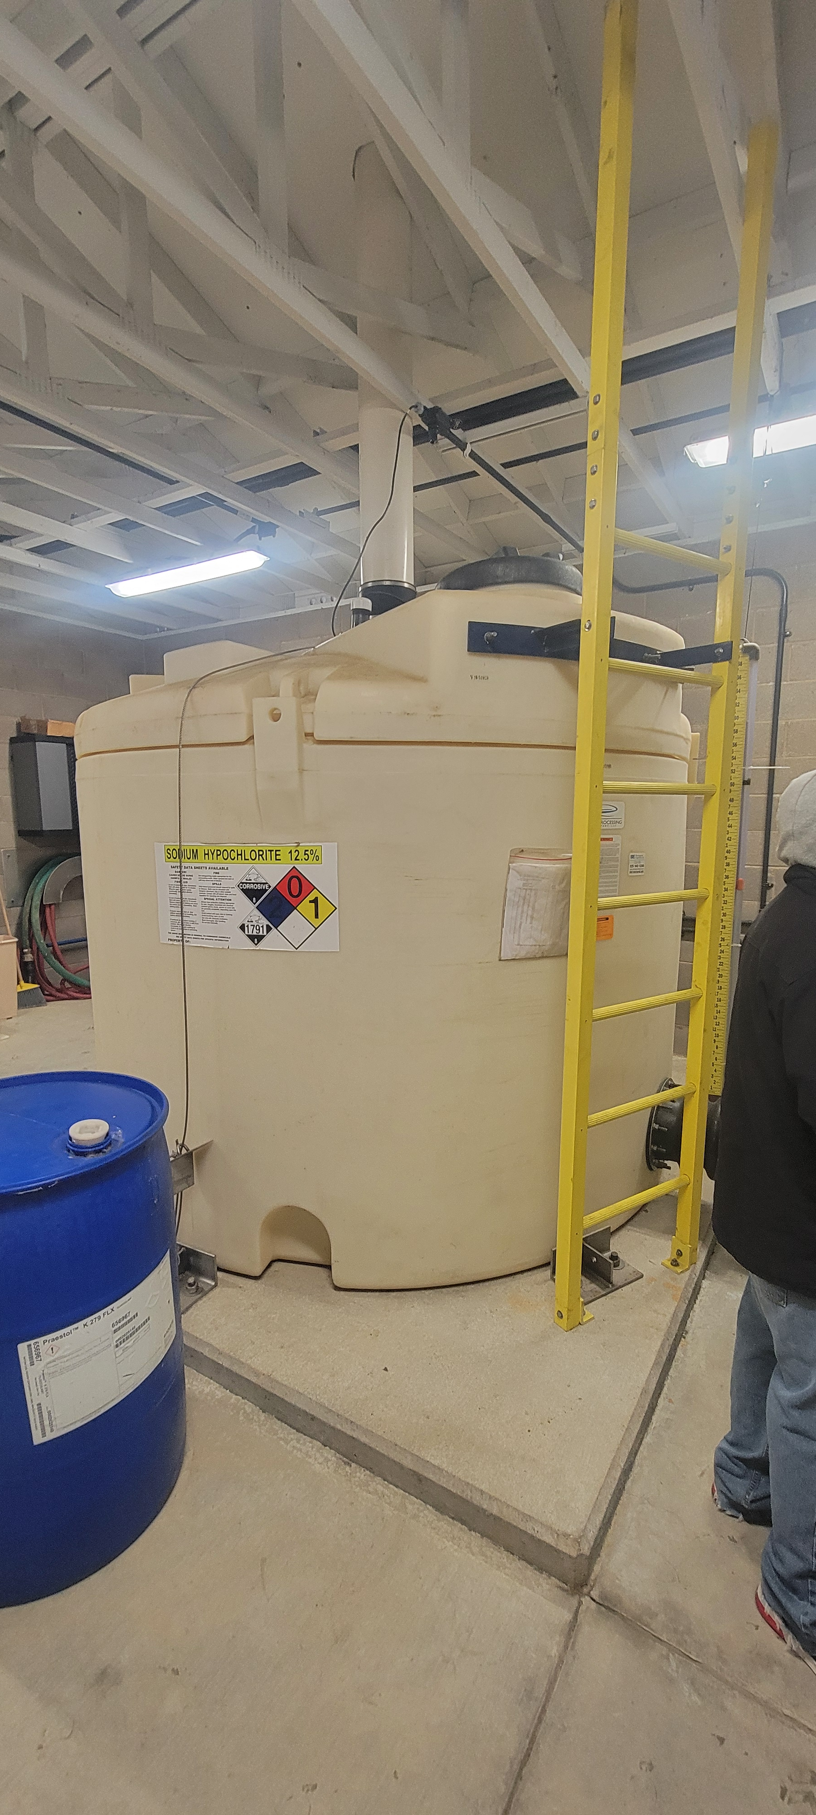
Some Key Budget Takeaways
Some annual budgeted operational costs of the plant in Jamestown include.
  $25,000 for sludge dewatering
  (New expense for Biola)
  $35,000 for sampling
  (More sampling than is currently required in Biola)
  $40,000 for maintenance
  (More than the current operation requires in Biola)
  $50,000 for sludge disposal
  (New expense for Biola)
  $55,000 for chemicals
  (New expense for Biola)
  $100,000 for utilities (water, power, etc.)

Slide 9
DISCUSSION
Jamestown
The effluent standards are changing for Jamestown. The district is currently looking to change their treatment process to something more efficient. They are considering retrofitting the plant to a membrane bio reactor (MBR). It will produce a much higher quality effluent. Their effluent is currently used for irrigating pasture for cattle. If they go with an MBR, it can open other opportunities to make a profit on their effluent.
Biola
If Biola were to use an MBR treatment plant, the district should be able to do the same. An MBR is considered tertiary treatment (further treatment of the final effluent). If Biola were to go this route, the sale of the treated effluent could help offset the cost of plant operations and maintenance. Surrounding farmers could buy the water for crop irrigation. Businesses could also purchase the treated water for industrial use as well.

Slide 10
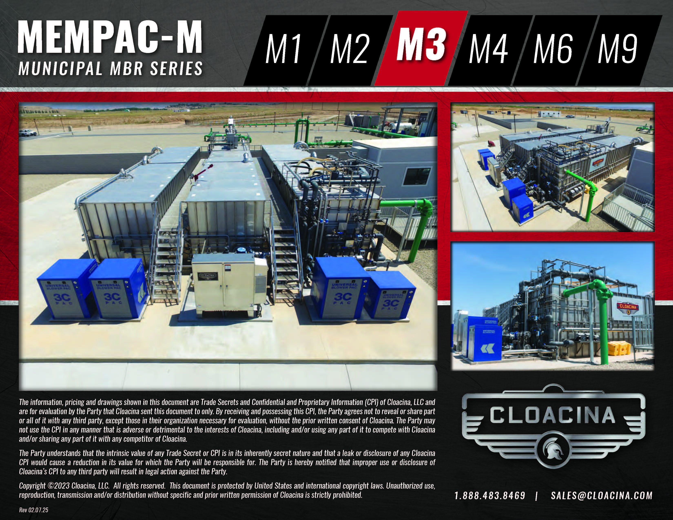
This MBR for example, is
manufactured at a
facility and delivered to
the end user for
installation. It is a modular system that can be easily expanded for future growth.

Slide 11
Thank you
Prepared By
Mountain Valley Environmental Services

Slide 12
QUESTIONS

Slide 13
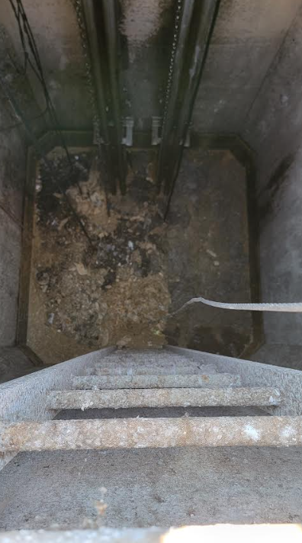
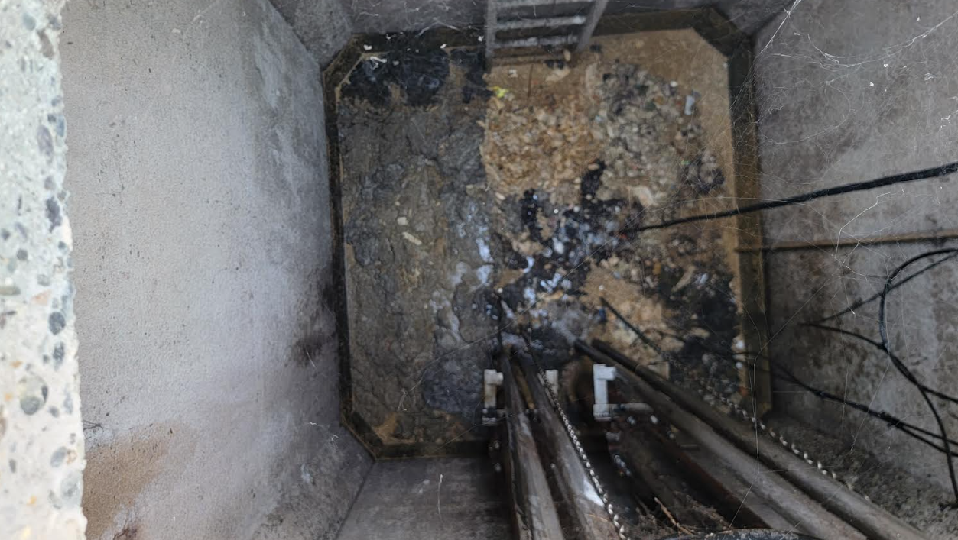

Slide 14
