Slide 1

BIOLA UPDATE
Billie Hansen | Recycling Programs Manager

Slide 2

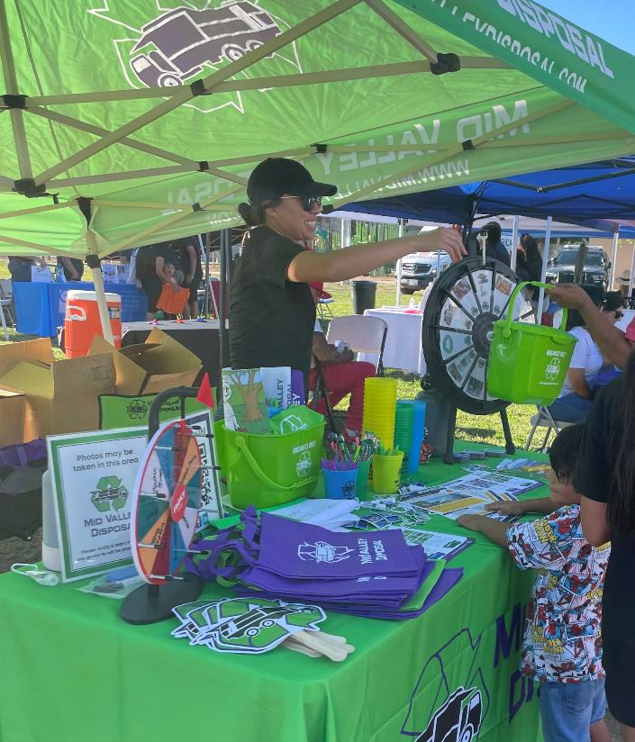
COMMUNITY EVENTS
Biola Raisin Parade-cancelled
4/13/2024 Clean Up Event
12/5/2024 Clean Up Event

Slide 3

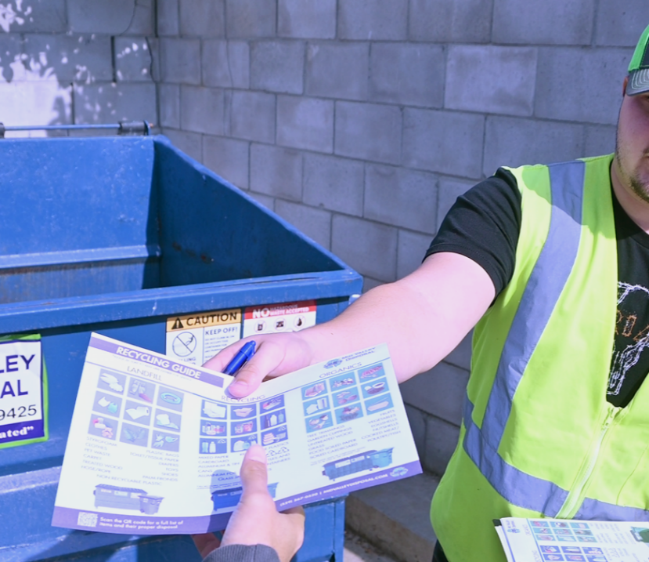
OUTREACH & EDUCATION
All Site Visits Completed
Over 1,000 educational fliers distributed to the community
All Tier 1 & Tier 2 food generators identified & provided education

Slide 4
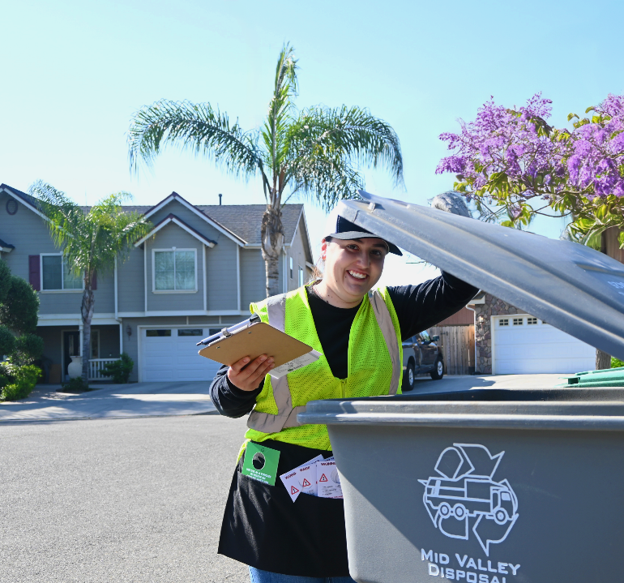
SB1383 - Contamination
Types of contamination monitoring:
  Driver tagging
  Annual Route Reviews: SB1383 program
    Route contamination Study
    Performed by recycling department

Slide 5
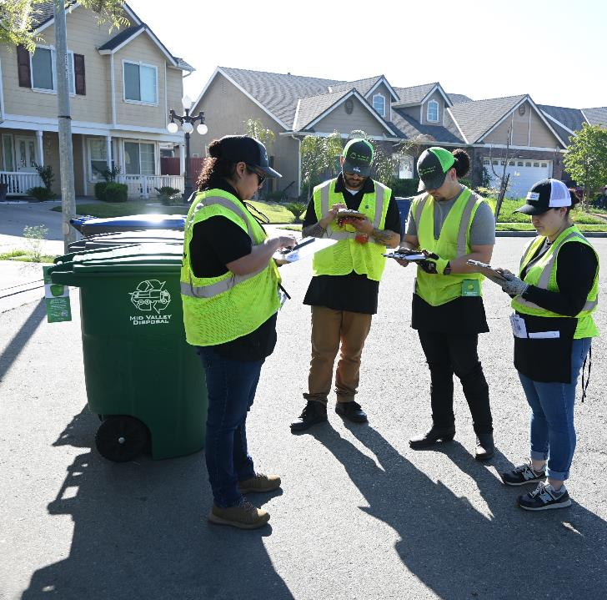
ROUTE REVIEW PROCESS
Route Identification
  Total Routes: 4
  Focus: Select a representative sample from concentrated stop areas
Duration
  1 Month Preparation: collaboration with operations
  1 Week: Fieldwork execution
Fieldwork Details
  Conducted over 1 Day (8 hours/day)

Slide 6
ROUTE REVIEW RESULTS

Slide 7

Recycler of the Year
Biola Pershing Elementary School

Slide 8
THANK YOU

